Slide 1

Winter: Rest and Compassion

Slide 2

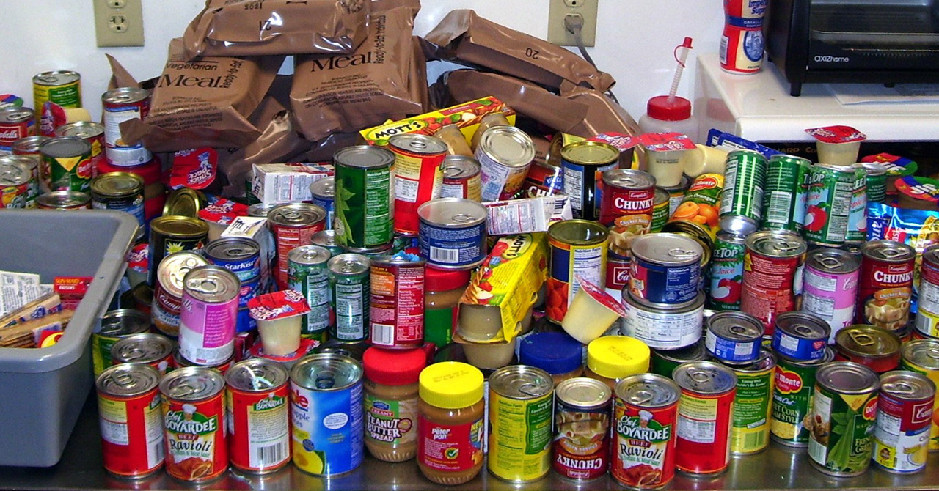
Caring for the Vulnerable
Support those affected by climate and economic hardship. Donate warm clothing to Clothing Banks/Salvation Army and to food banks

Slide 3


Mindful Celebrations
Celebrate Christmas with less waste—
Reuse decorations
Give a gift experience
Recycle wrapping and cards
Use environmental friendly or recyclable gift wrap
Use plastic free or recyclable crackers
Use cards as gift tags
Reduce food waste – buy what is needed and use leftovers for Boxing Day!

Slide 4
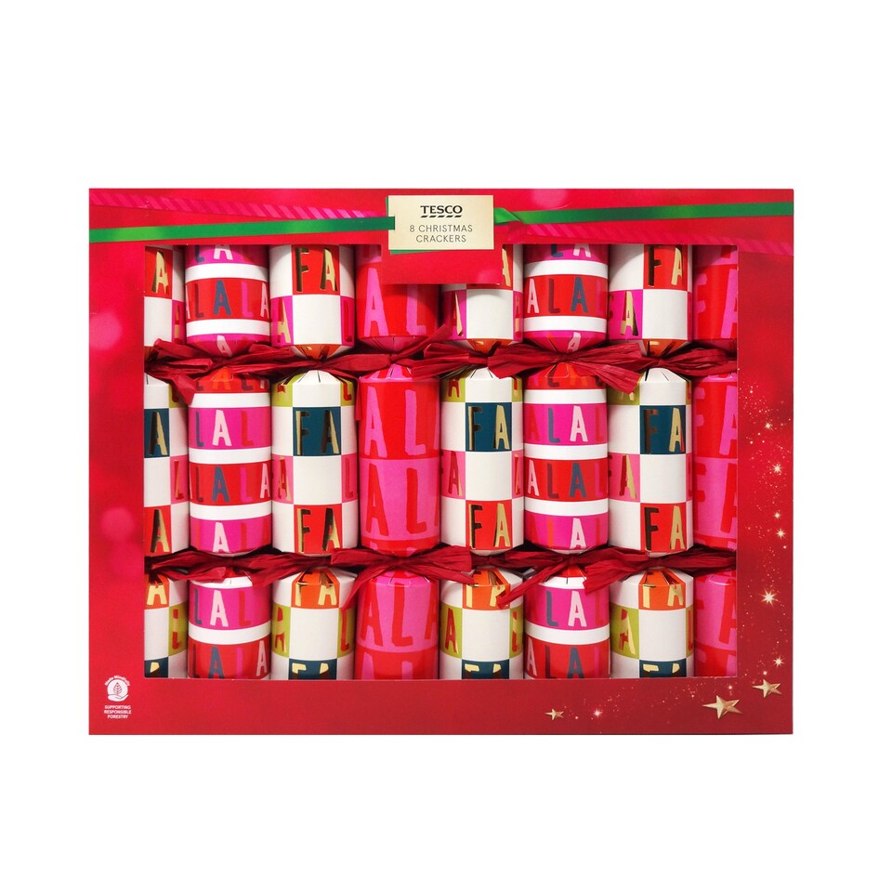
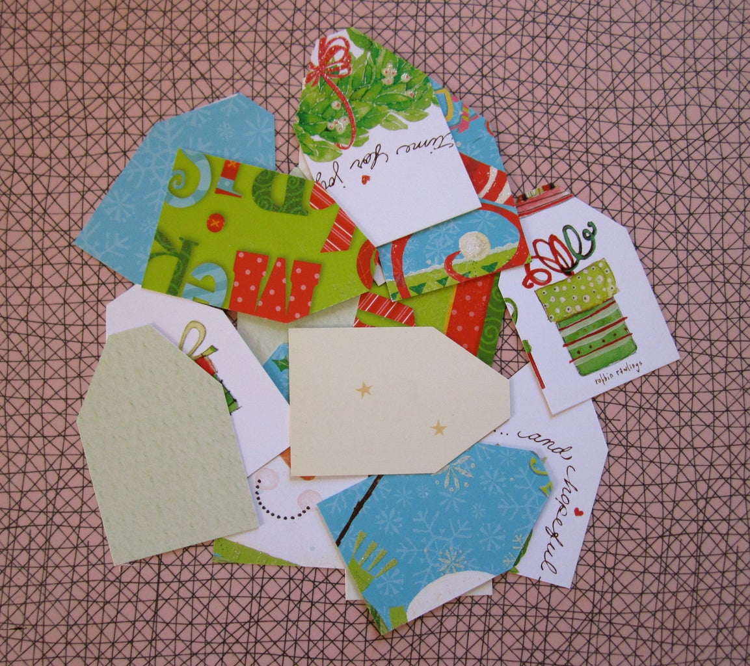
Recycling
Use last year’s Christmas cards for gift tags or keep this year for next time!
Plastic free or recyclable Christmas crackers now on sale (Tesco, Aldi and Home Bargains)

Slide 5
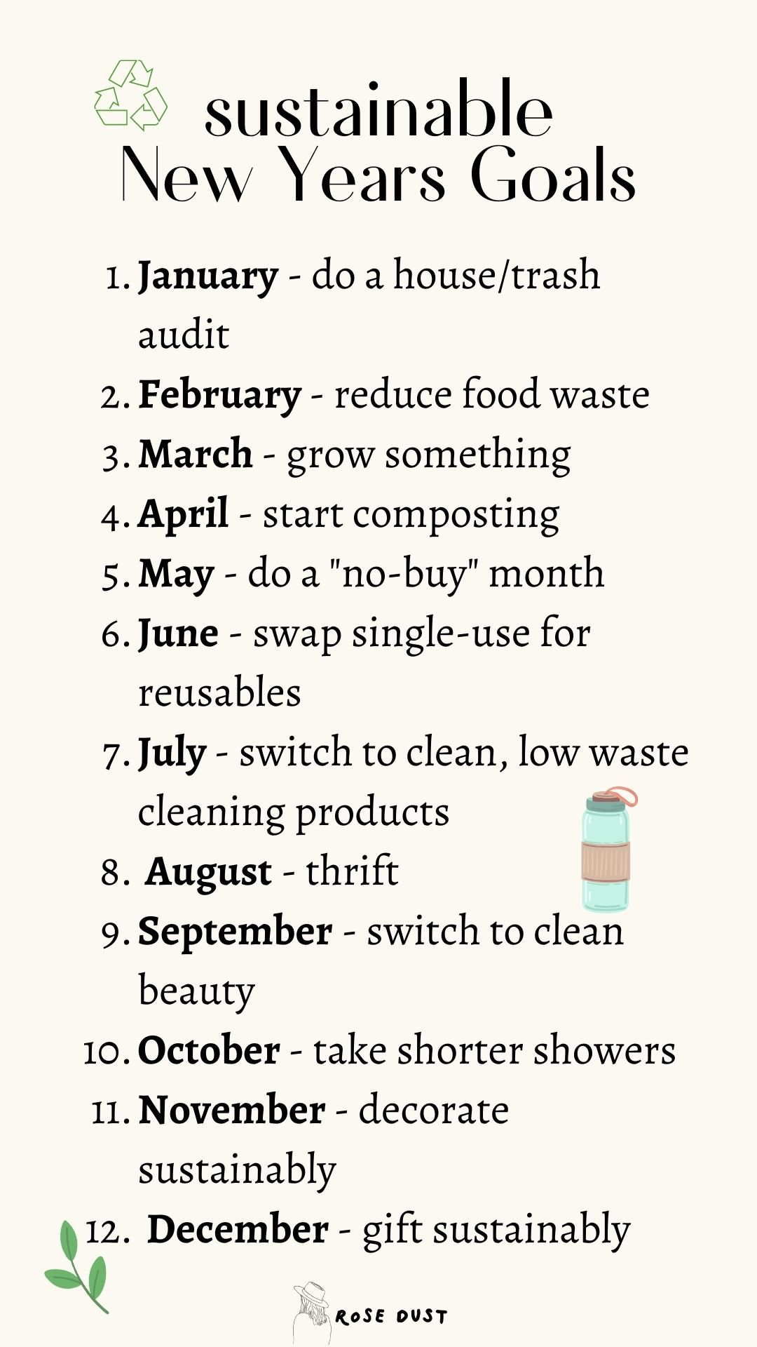
Planning for Change
Use winter to plan sustainable goals for the new year. Reflect on how your faith guides your environmental choices

Slide 6

Church and Community Support
Host warm spaces and sustainability workshops. Be a beacon of hope and care in your community.

Slide 7

Prayer for Winter
God of peace, thank you for the quiet of winter. May we find rest and renew our commitment to care for your world.

